Slide 1


Persecution of Women in Post-coup Turkey

Slide 2
Turkey’s Extended State of Emergency
Turkey has declared the state of emergency after the coup attempt on July 15, 2016. The state of emergency allowed President Erdogan to not only become an autocratic leader, but also start a massive crackdown. Around 65,000 people were arrested. Unfortunately, women are one of the most vulnerable target of this witch-hunt. There are approximately 17,000 women in Turkish prisons along with 668 children (1).

Slide 3
Violation of Laws and Rights
According to article 16 of the Law on the Execution of Sentences and Security Measures states that “Execution of sentences for pregnant and puerperant women shall be delayed for six months”.
Article 12 of CEDAW emphasises the situation of pregnant women and imposes some obligations on the states parties “during their pregnancy and post-natal periods”.

Slide 4
CEDAW
“The Convention on the Elimination of all Forms of Discrimination Against Women (CEDAW) is an international treaty adopted in 1979 by the United Nations General Assembly.”
The convention aims to eliminate discrimination and inequality towards women. There is special emphasis on the rights and legal protections of pregnant and nursing women. It is stated that women with pregnancy and post-natal period receive required free services like health care and adequate nutrition (2).

Slide 5
Turkey clearly violates not only the universal principles of law, but also the essential obligations of the convention.
Women are jailed with their newborn babies under horrible ward conditions.
Women who are breastfeeding are required to have a rich diet in order to provide enough nutrition for their babies. However, in Turkish jails women are left to share their with their babies and children often suffer from malnutrition.
There are not enough beds and the inmates sleep by taking turns due to the overcrowded wards. Children are not provided with cribs and sleep with their mothers at the risk of an injury of falling or choking.
Every child deserves to live in a happy environment where food, toys, healthcare should not be a concern. Unfortunately, the children in prisons often get sick due to poor diet and only play with plastic food wraps or cardboards (4).

Slide 6
“Based on monitoring government decrees and other reports from official sources, by the end of August 2017, advocacy groups had highlighted some 668 cases of children under the age of 6 being held in jails with their mothers. And 23 percent of those youngsters were infants less than a year old” (23).
According to BBC news reports, hundreds of women are in jail along with their children, 149 of them are younger than a year old infants.

Slide 7
United Nations High Commissioner for Human Rights
Report on the impact of the state of emergency on human rights in Turkey
OHCHR documented at least 50 cases of women who had given birth just prior to or just after being detained or arrested. OHCHR received a report concerning a woman who was sexually assaulted by a police officer during arrest.
Moreover, NGOs brought to the attention of OHCHR at least six cases of women who were detained while they were visiting their spouses in prison. They were either detained together with their children or violently separated from them (24).

Slide 8
“Mothers and children exposed to such practices face serious risks of health complications, stunting and even death. Their situation may amount to torture, cruel, inhuman or degrading treatment. Due to stress, many women report being mentally unwell and unable to breastfeed or to look after their children who are imprisoned with them. OHCHR recalls that, according to the Bangkok Rules, the State should ensure that children held with their imprisoned mothers are never treated as prisoners, and that the environment in which children are detained is as close as possible to conditions outside prisons. A comprehensive individual assessment for each child should be made considering the best interests of the child, and non-custodial measures should be preferred for pregnant women and those with dependent children” (24).

Slide 9
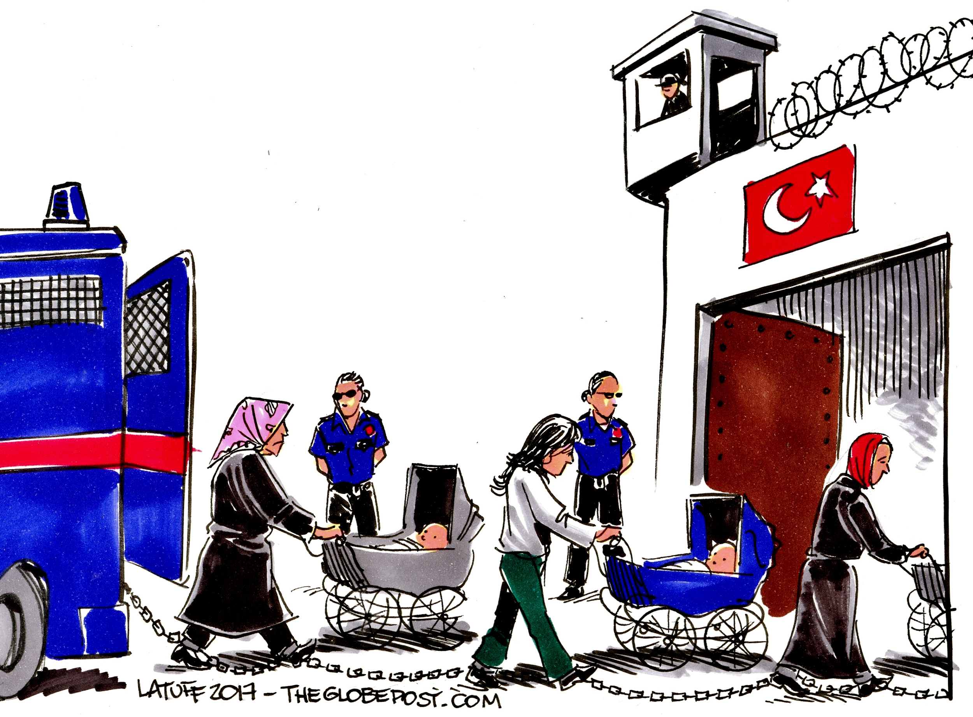

Slide 10
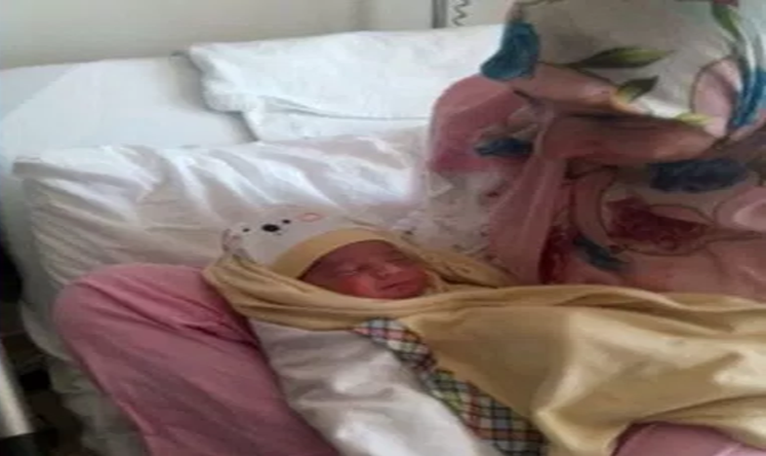
Mothers in Despair
Fatma Ozturk, a teacher, was handcuffed to her hospital bed just hours after she delivered her baby in Manisa/Turkey on July 9, 2017. She was detained despite her and the baby’s critical health condition (3).

Slide 11
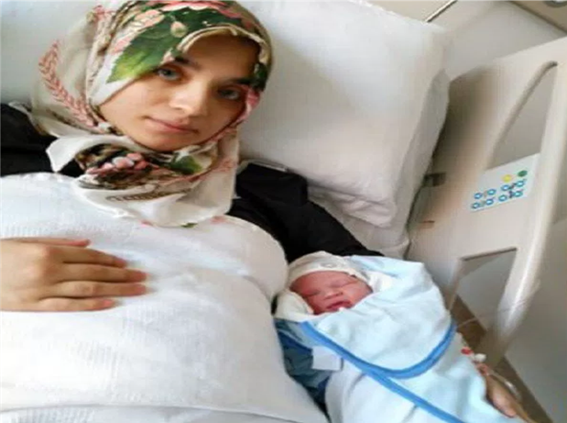
Hatice Avan was detained on the day after her delivery, despite the doctor’s objection. She was suffering from poor health after the surgery when she was taken to the prosecutor’s office. She was accused for having ties with and having worked at a Gulen based dormitory in the past (3).

Slide 12
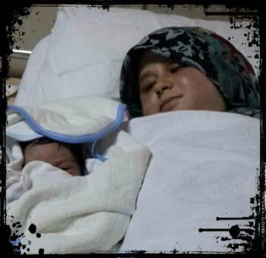
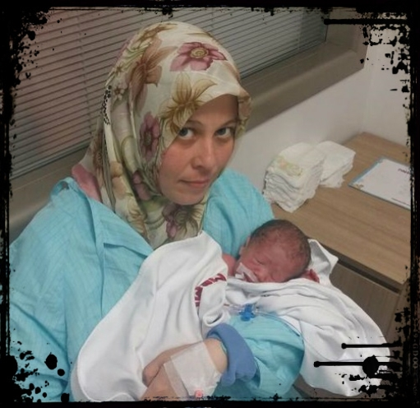
Elif Acikgoz was detained after hours of her C-section surgery. Acikgoz, whose husband is also in jail, was taken to the police station despite the doctor’s objections on August 21. She was later released with condition of judicial probation (3).
Feyza Yazici was detained the day after giving birth to a premature baby in her 33th week in Ankara. She was later released pending trial (3).

Slide 13
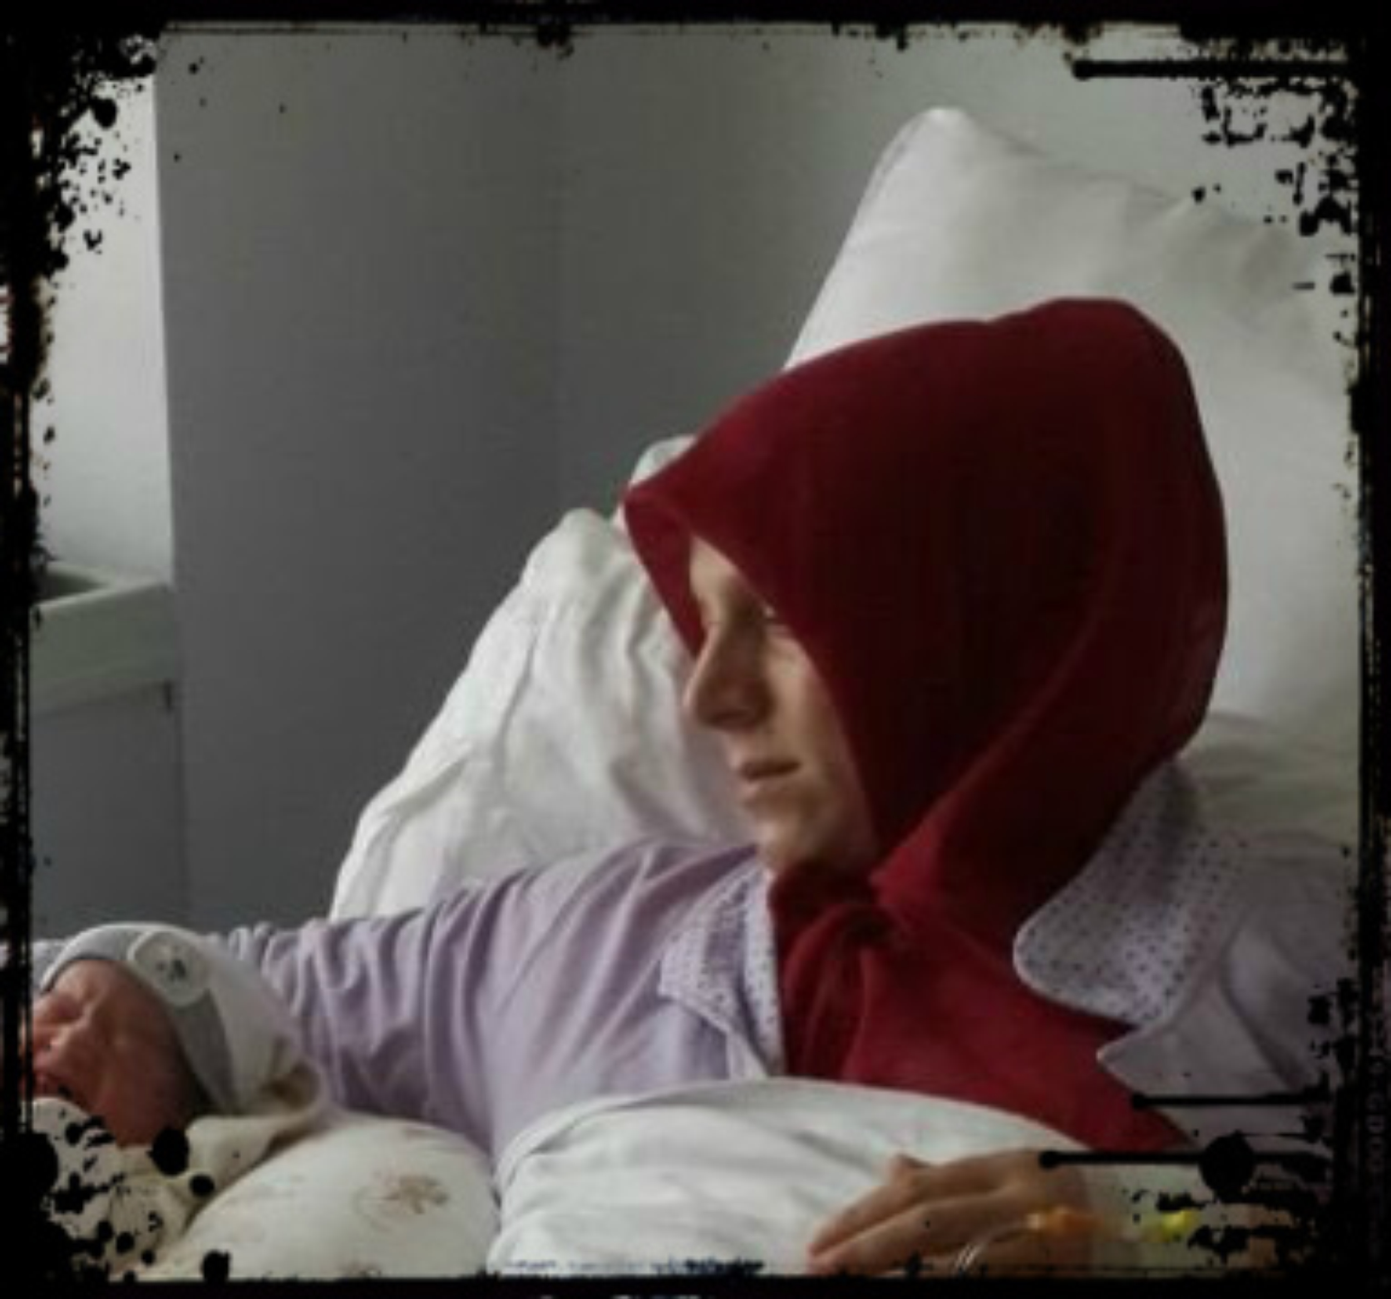
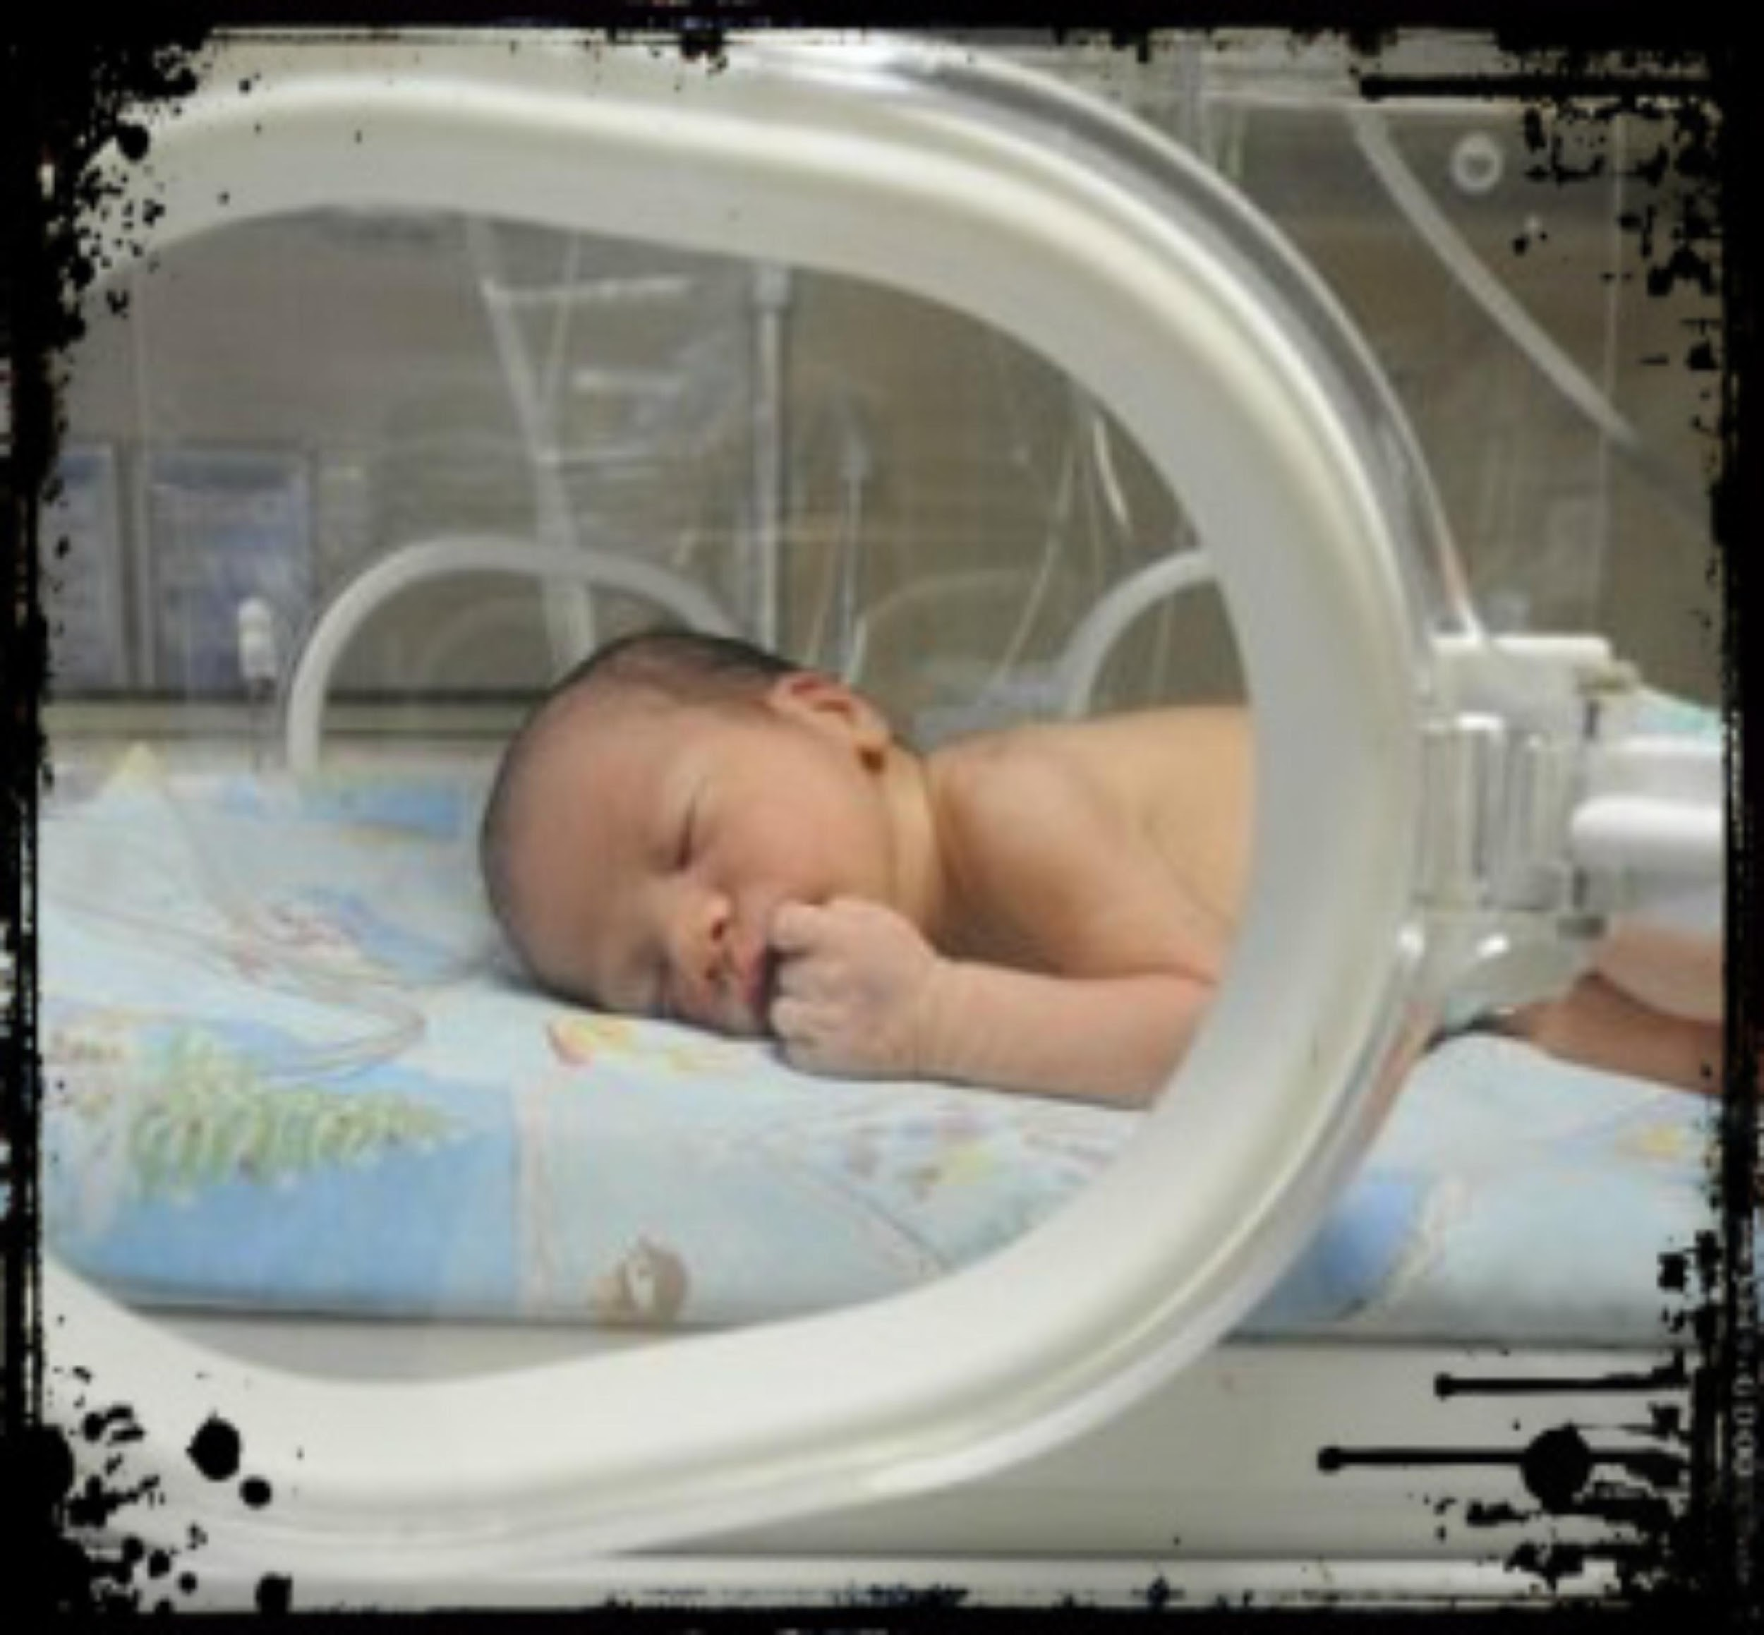
Havva Hamamcioglu, a housewife whose husband has also been jailed, was detained after the day of her delivery on June 11, 2017 (3).
S.A, mother of a week old premature baby, was take into custody on her way to the hospital to feed her baby (3).

Slide 14
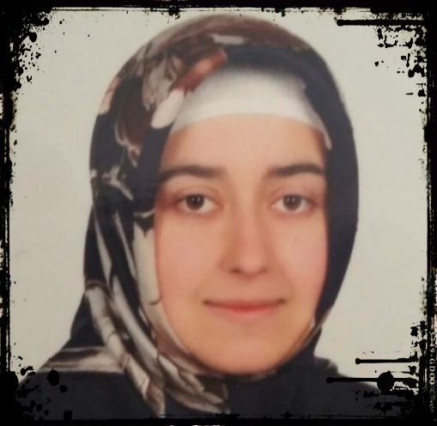
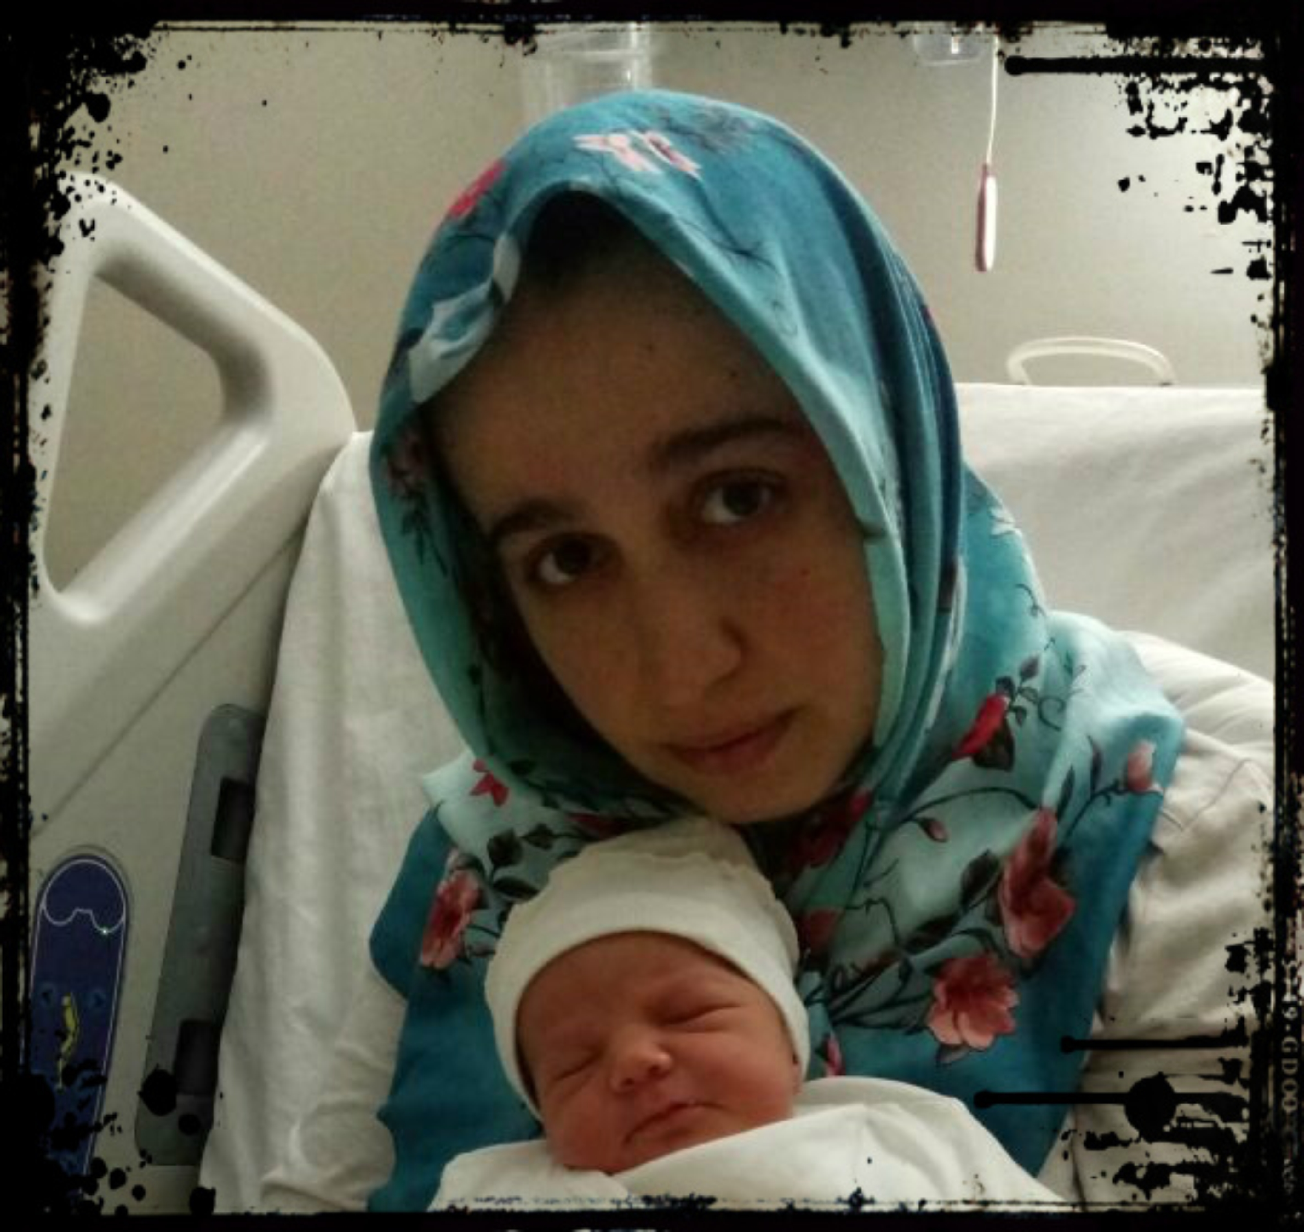
Nuriye Yalcin, 4.5 months pregnant, was expecting twins. She was detained during a medical control on July 4 (3).
Aysun Aydemir, English teacher, was detained with her 3 day old baby on May 12, after an elective caesarean surgery. She was later released and put under house arrest along with an electronic bracelet (3).

Slide 15
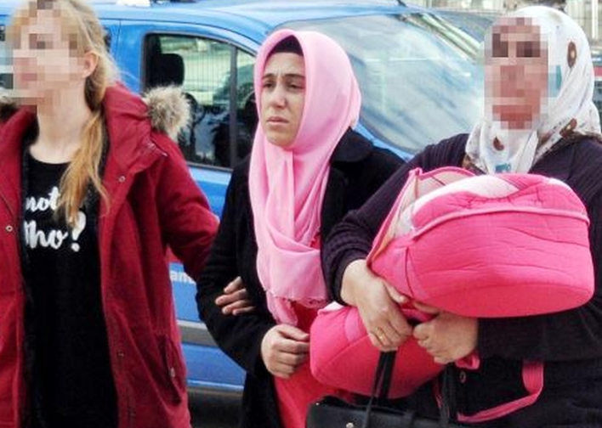
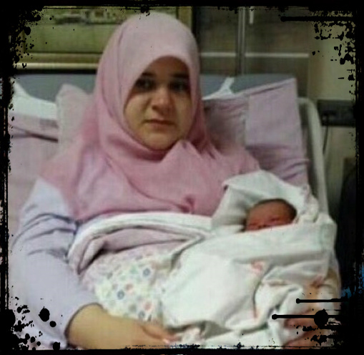
Fadime Gunay was detained on the day after her delivery. While she was giving birth at the hospital, the police awaited to detain her. She, along with her baby, was brought to the courthouse the next day (3).
Ayse Kaya was detained on the same day of her delivery in Istanbul on July 25. She was transferred to a Police Station in Edirne, 240 km away from Istanbul (3).

Slide 16
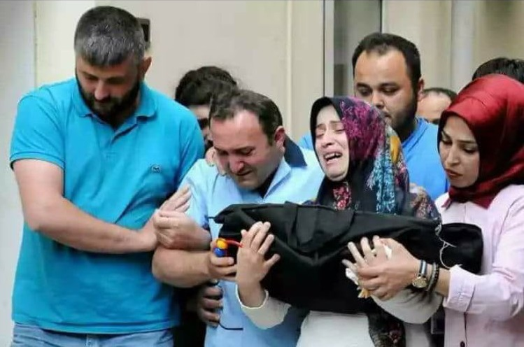
Büşra Atalay, a pregnant woman with 6 month of twin babies, was detained by police at Yüzyıl Hospital in İstanbul’s Pendik district. Atalay, who puked while police began to take the statement, was taken to the Medicalpark Hospital. The mother who was in the early birth process was taken to the emergency caesarean surgery. During this process she lost one of her babies, the girl. The other baby is reportedly in intensive care. The police awaits at the door in order to detain (5).

Slide 17
Another pregnant woman, who was imprisoned in T-Type Prison, and her baby have lost their lives because of the negligence of the prison administration. According to the report, although the female prisoner, who was jailed over her alleged links to the Gülen movement, told the prison administration repeatedly that she did not feel her baby, she was not taken to a hospital. At the last minute, she was reportedly taken by prison administration to the Ereğli State Hospital first and then she was decided to be transferred to Konya province by ambulance since she got worse. However, 50 km away from the hospital in Konya she lost her life on the way. It was claimed that the pregnant woman has died because of blood poisoning due to the dead fetus in her womb (6).

Slide 18

5 children were abandoned in the parking lot of Sincan Prison in Ankara after their mother was detained while making a visit to their father in prison. The children were in tears.
“We are five brothers, left alone. We have a handicapped brother. I commend those people to God’s punishment”, said the older brother (7).

Slide 19
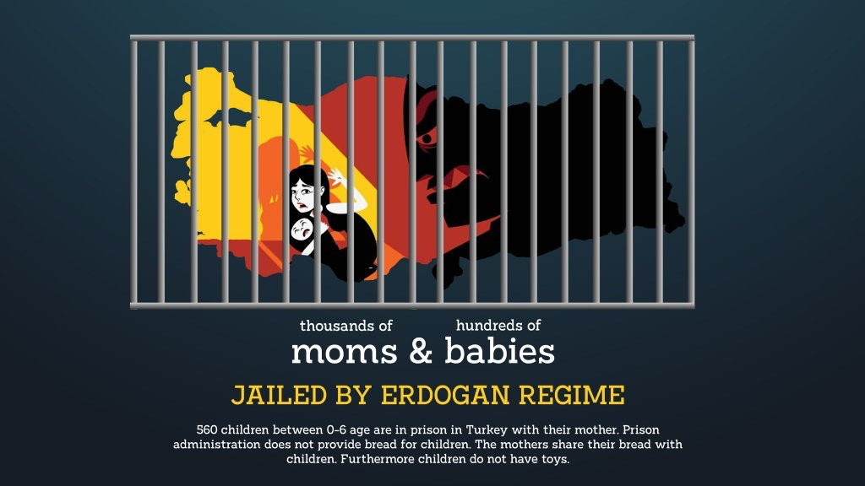

Slide 20
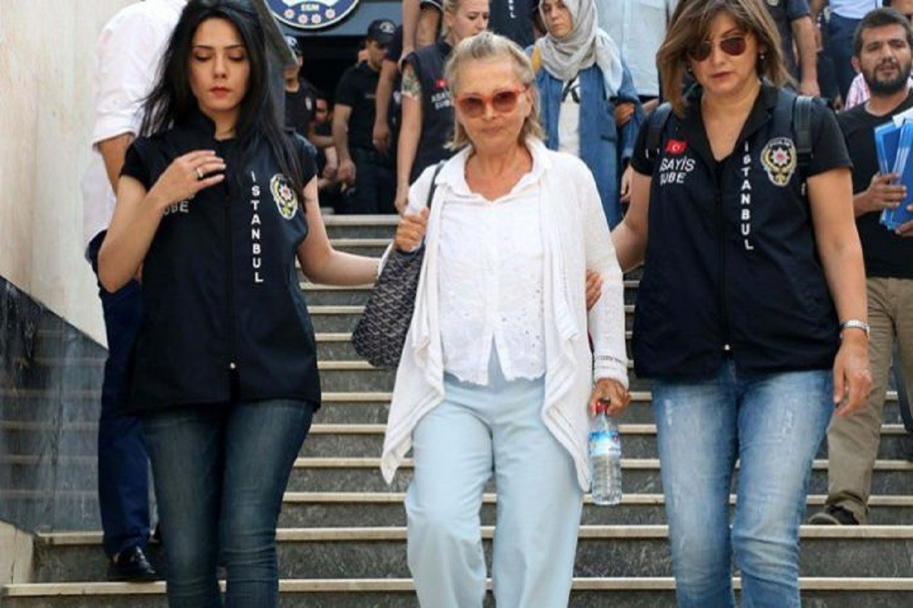
Nazli Ilicak, a Turkish journalist, is in jail since July 29, 2016. She is charged with “being a member of a terrorist organization” and is given life sentence by the Turkish court. Ilicak will also be denaturalized from Turkish Republic of Northern Cyprus citizenship (8).

Slide 21
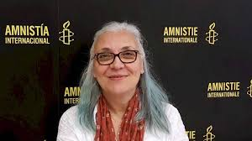
Amnesty director Idil Eser facing 15 years in jail
on terrorism charges in Turkey
The activists have been charged with membership of, and with aiding, an "armed terrorist organisation", reported the Dogan news agency. Eight people including Amnesty International's director in Turkey, Idil Eser, were arrested in July when Turkish police raided a "digital security and information management workshop".
Ms Eser was held "in the highest security area of the highest security prison in Turkey", according to an Amnesty statement which said the terror charge was "a ridiculous and baseless accusation" (9). She was released by court after 4 months.

Slide 22
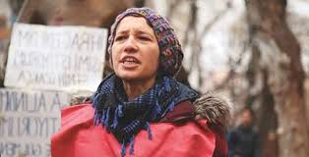
Nuriye Gulmen has been on hunger strike for months, after losing her job. She was accused of belonging to a far-left group and was sentenced with 6 years and 3 months of imprisonment. Her health was severely affected due to weight loss and starvation during the strike (10).

Slide 23
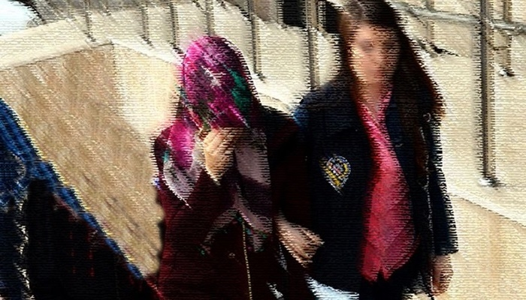
Torture
Tugba Y, mother of three, has lost sanity due to weeks of torture. She, along with her husband, had been interrogated for 24 days and then put in prison. The ill-treatment, violence and the torture massively impacted her mental health and led to insanity. The victim was hospitalized in Bakirkoy Psychiatric Hospital however, was re-arrested despite the doctor’s reports on heavy torture. One of the victim’s child is a leukemia patient and needs special care (11).

Slide 24
Zehra Yilmaz who had been in jail, away from her sons, for more than a year due to alleged links to Gulen movement shared a tragic story of her cellmate, Asli, getting tortured.
“As soon as Asli was brought into the room, female police officers took off all her clothes and beat her until she was unconscious. She was hearing her husband’s screams from the next room, as she was also screaming from pain. The officers were insulting them loudly at the same time. The torture didn’t stop there. The male police officers were pounding on the door, demanding to rape her. And female officers inside the room told her that they would let these men rape her if she didn’t confess. Her husband in the next room was begging to make it stop since he heard everything from the adjacent room. As part of a routine procedure, Asli was taken to a hospital for a health screening. She requested an injury report after the questioning, but the doctor instead prepared a report that she is perfectly healthy. There was no way for her to prove that she was tortured” (12).

Slide 25
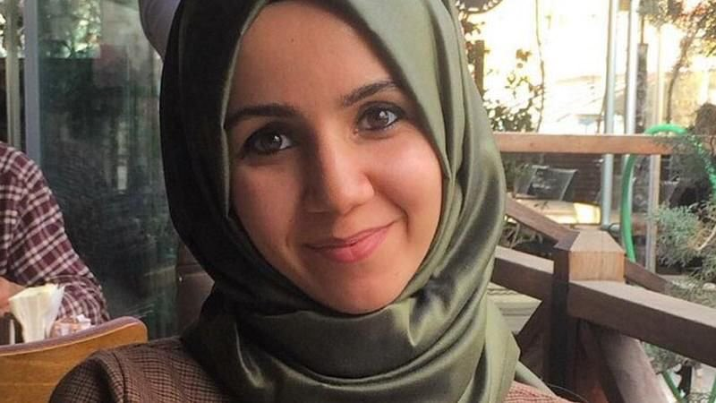
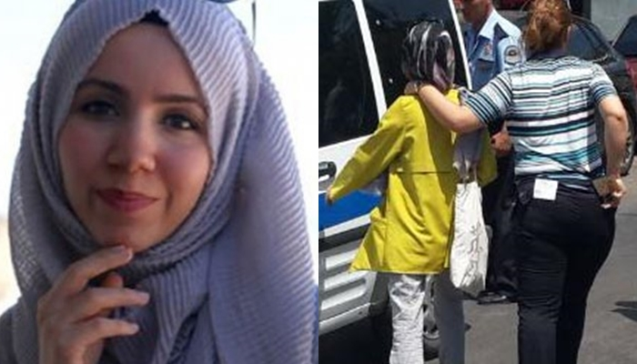
27 year old journalist Aysenur Parildak was sentenced to 7.5 years in prison. She was charged for having worked at Zaman, Gulen newspaper, and has been under arrest since August 11, 2016. She wrote a letter to Cumhuriyet about solitary confinement and sexual harassment in October 2016. This action led to a ban on letters being sent from Silivri prison (13).

Slide 26

Aysenur Parildak’s letter:
“I was subjected to violence and sexual abuse. I was interrogated day and night for eight days. They [police officers] were questioning me while they were under the influence of alcohol and were not avoiding saying this. Then the court process began, and here I am. I stayed here in a ward for one month. Then 20 people were taken out of wards and placed in cells, which is solitary confinement. … I am afraid of being forgotten here.”

Slide 27
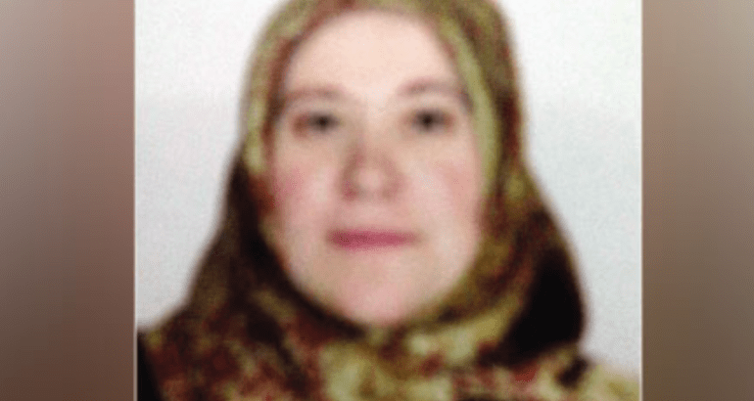
Illnesses and Prison Conditions
Fatma Bektas had been in prison for 15 months despite her serious illnesses: alzheimer's, cardiac and herniated disc. Bektas couldn’t remember why she was in jail and was unable to defend herself in the court. Her release requests were rejected even though she had a heart attack and vaginal bleeding from ovarian cysts (14).

Slide 28
Article 116 of Law No. 5275 says that the execution of a sentence may be delayed for detained persons due to an illness.

Slide 29
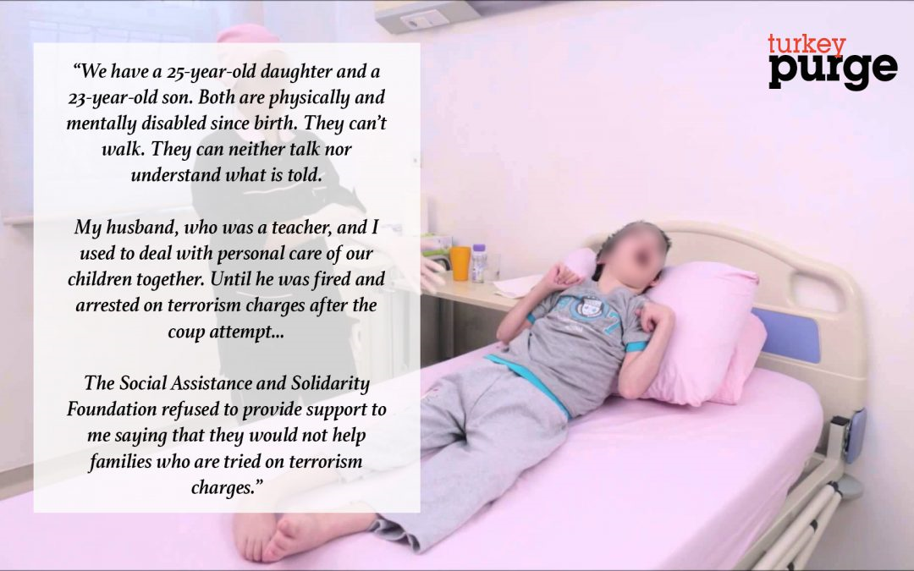
Housewife left to take care of disabled children alone after husband arrested (15).

Slide 30
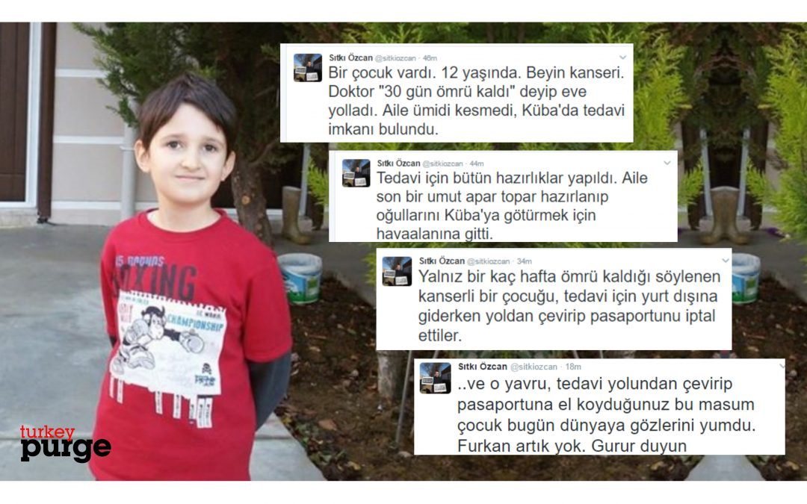
Escaping is not an Option
Furkan was a 12 year old cancer patient. He was diagnosed with brain cancer and the doctor told he only had 30 days left. The family decided to take their son to Cuba for treatment and was hopeful. However, when they were at the airport, they were not allowed to leave the country and their passports were cancelled. Even though the family begged the officers to let their son go to receive treatment, they were denied. Furkan had a tragic death, the cancer advanced, part of his face became paralyzed and he suffered loss of vision (16).

Slide 31
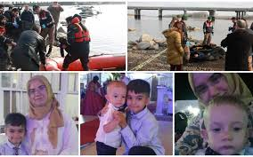
Three children, two women, and three men tried to get to Greece by crossing the Meriç/Evros river using a rubber boat. The rubber boat was capsized, and two children, estimated to be around 11 (Enes Abdurrezzak) and 3 (Halil Munir Abdurrezzak), and their mother (Ayşe Söyler Abdurrezzak) drowned. The rest of the people that were in the same boat are missing. Ayşe Söyler Abdurrezzak, a 37-year-old teacher, and her husband were dismissed from their job due to crackdowns after the failed coup attempt (17).

Slide 32
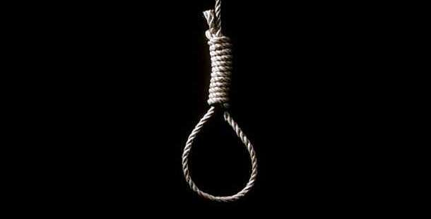
SUICIDE
“A total of 35 people who or whose relatives have been affected by the post-coup purge, either by losing their jobs or by being arrested, due to their alleged links to the movement, have committed suicide, the main opposition Republican People’s Party (CHP) said in a report in late April, this year.” (TurkeyPurge)

Slide 33
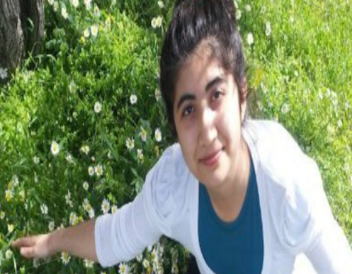
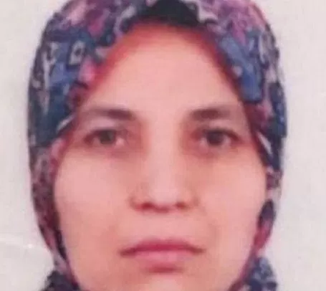
Tugce Olcer, 21 year old, was a fourth-grade student in Bogazici University. She was dealing with depression after her father’s imprisonment. Unfortunately, Olcer jumped off a balcony and passed away (18).
H.G, 60 year old woman, hanged herself in her house in Aydin/Turkey. During her husband’s imprisonment for 10 months, she suffered from physiological collapse and had difficulties with working at their small stationery store(19).

Slide 34
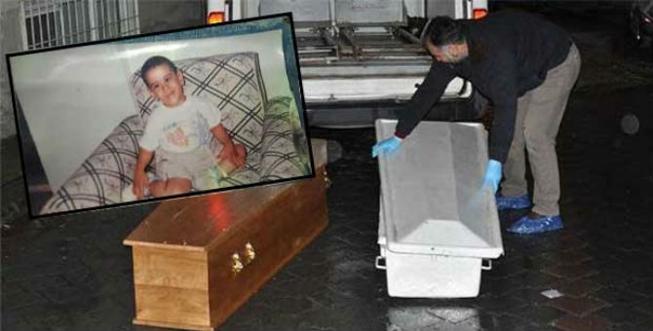
Eyup Ozturk was a 17 year old boy suffering from cerebral palsy. He was shot dead by his mother S.B after his father was discharged from his job and put in jail. S.B, who divorced from her husband a year ago, was unable to meet their needs and committed suicide after shooting her son (20).

Slide 35
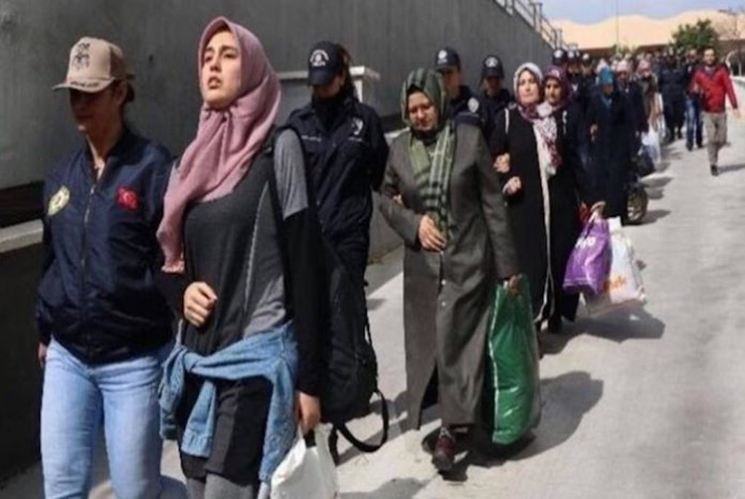
Turkish gov’t issues detention warrants for 121 women on International Women’s Day (21).

Slide 36

“Turkey systematically and deliberately jails women as part of fear and intimidation campaign” (22).

Slide 37
References
http://www.turkishpedia.com/2017/03/27/women-victims-of-state-of-emergency-in-turkey/
https://en.wikipedia.org/wiki/Convention_on_the_Elimination_of_All_Forms_of_Discrimination_Against_Womenhttp://tbinternet.ohchr.org/Treaties/CEDAW/Shared%20Documents/IRL/INT_CEDAW_NGO_IRL_26357_E.pdf
https://turkeypurge.com/mothers-of-turkeys-purge
https://stockholmcf.org/wp-content/uploads/2017/04/Jailing-women-in-Turkey.pdf
https://stockholmcf.org/turkish-govt-puts-669th-baby-behind-bars-over-his-parents-alleged-links-to-gulen-movement/
https://stockholmcf.org/authorities-negligence-kills-a-pregnant-woman-and-her-baby-in-turkish-prison/
https://stockholmcf.org/campaign-launched-for-5-children-abandoned-after-mother-detained/
https://stockholmcf.org/jailed-turkish-journalist-ilicak-to-be-denaturalized-by-kktc-over-her-alleged-links-to-gulen-movement/
https://news.sky.com/story/amnesty-director-in-turkey-facing-15-years-in-jail-on-terrorism-charges-11072565
https://www.reuters.com/article/us-turkey-security-hungerstrike/turkish-hunger-striker-found-guilty-of-militant-links-freed-idUSKBN1DV5QM
https://turkeypurge.com/teacher-who-lost-sanity-under-detention-being-kept-in-jail-despite-doctor-reports
https://www.theglobepost.com/2017/08/25/turkey-tortured-prison/
https://turkeypurge.com/journalist-aysenur-parildak-sentenced-7-5-years-jail
https://stockholmcf.org/turkish-govt-keeps-woman-with-heavy-alzheimers-in-jail-for-15-months-over-witness-statements/
https://turkeypurge.com/housewife-left-to-take-care-of-disabled-children-after-husband-arrested
https://turkeypurge.com/?s=furkan+cancer
http://silencedturkey.org/tag/abdurrezzak-family
https://turkeypurge.com/tag/tugce-olcer
https://stockholmcf.org/60-year-old-turkish-woman-commits-suicide-as-husband-under-arrest-for-10-months/
https://turkeypurge.com/17-year-old-disabled-boy-shot-dead-mother-father-arrest-post-coup-crackdown
https://stockholmcf.org/turkish-govt-issues-detention-warrants-for-121-women-on-intl-womens-day-over-alleged-gulen-links/
https://stockholmcf.org/turkey-systematically-and-deliberately-jails-women-as-part-of-fear-and-intimidation-campaign/
http://www.foxnews.com/world/2018/02/13/hundreds-young-turkish-children-jailed-alongside-their-moms-as-part-post-coup-crackdown.html
http://www.ohchr.org/Documents/Countries/TR/2018-03-19_Second_OHCHR_Turkey_Report.pdf

Slide 38
SUPPORT THE VICTIMS IN TURKEY
CONTACT US
help@silencedturkey.org
+1(540)209-1934 Twitter:@silencedturkey Facebook:@silencedturkey
DONATE ONLINE
silencedturkey.org gofundme.com/ advocatesofsilencedturkey
SEND YOUR CHECKS PAYABLE TO:
'Advocates of Silenced Turkey' to P.O.Box 2399 Wayne, NJ 07474-2399

