Slide 1
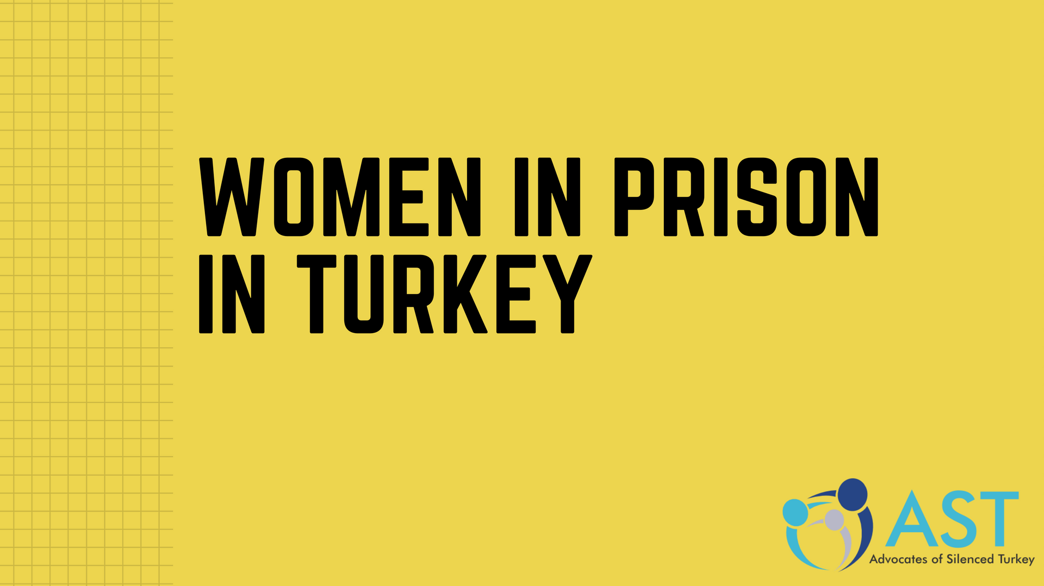

PRISON CONDITIONS FOR WOMEN AND CHILDREN IN TURKEY

Slide 2
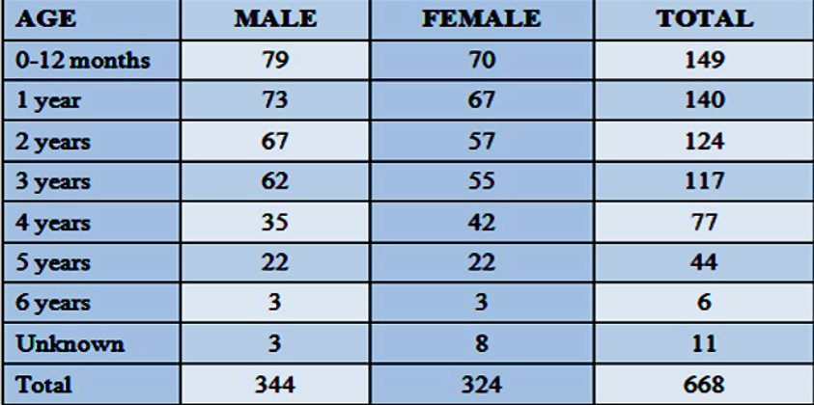

686 BABIES AND OVER 17,000 WOMEN ARE HELD ILLEGALLY IN TURKISH PRISONS

Slide 3
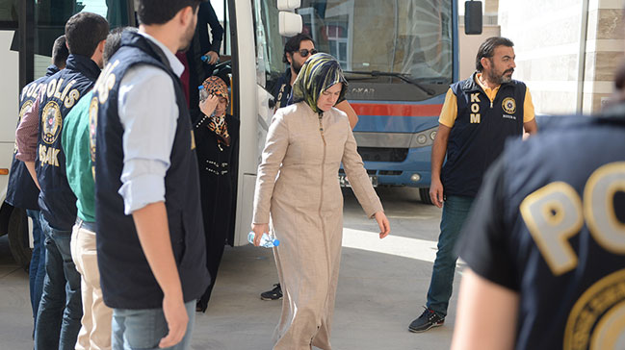
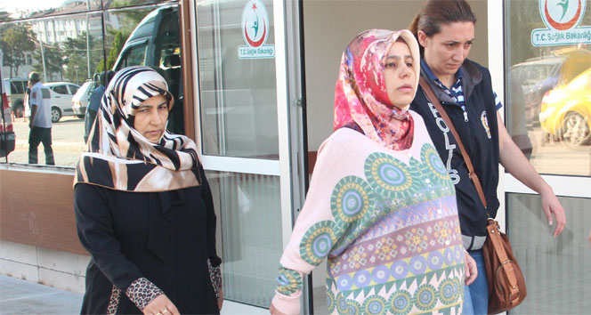
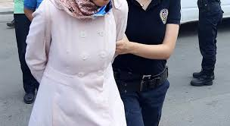
They are in pre-trial detention and not yet convicted!
Current conditions have negative impact on physical and mental health of imprisoned women:
Long term detention and not allowed to access a lawyer.
Strip search, verbal and physical harassment and torture.
Poor conditions of jails.
Denial of Health Services.

Slide 4
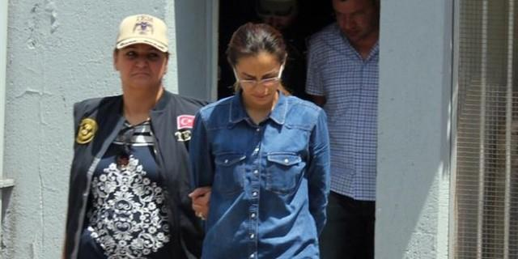
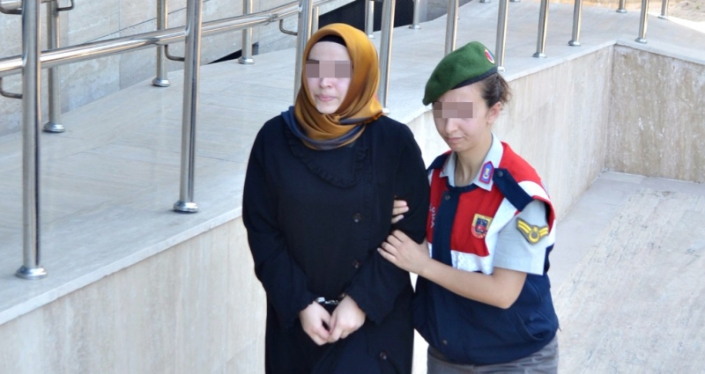
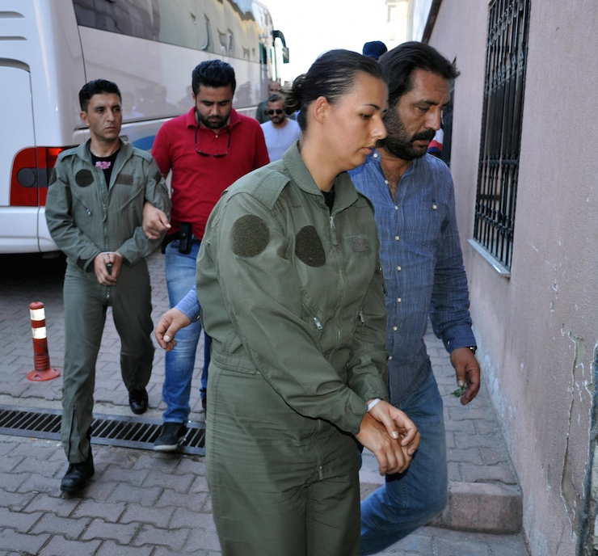
1. Long term detention and not allowed to access a lawyer
Prosecutors have authority to;
- increase the detention period from four days to 30 days.
- deny detainee to see her lawyer for up to five days.

Slide 5
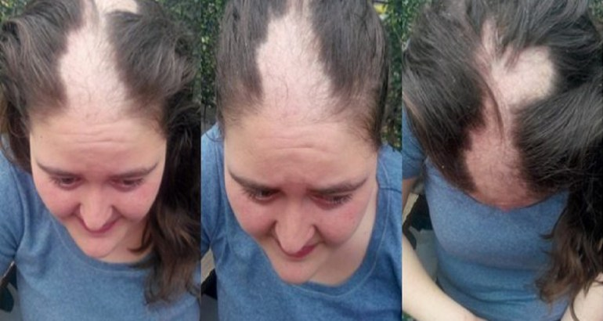
2. Strip search, verbal and physical harassment and torture
Turkish Constitution Article 17 and Article 3 of the European Convention on Human Rights states that “No one shall be subjected to torture or to inhuman or degrading treatment or punishment”.

Slide 6
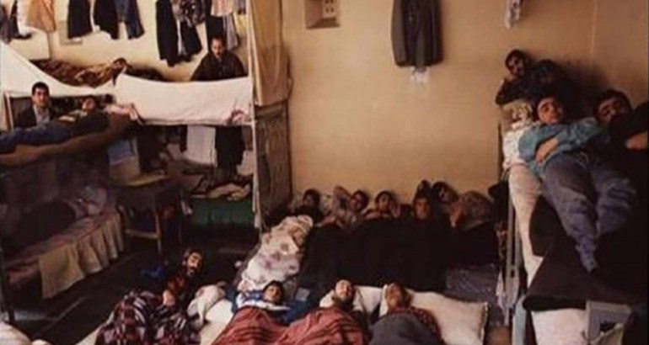
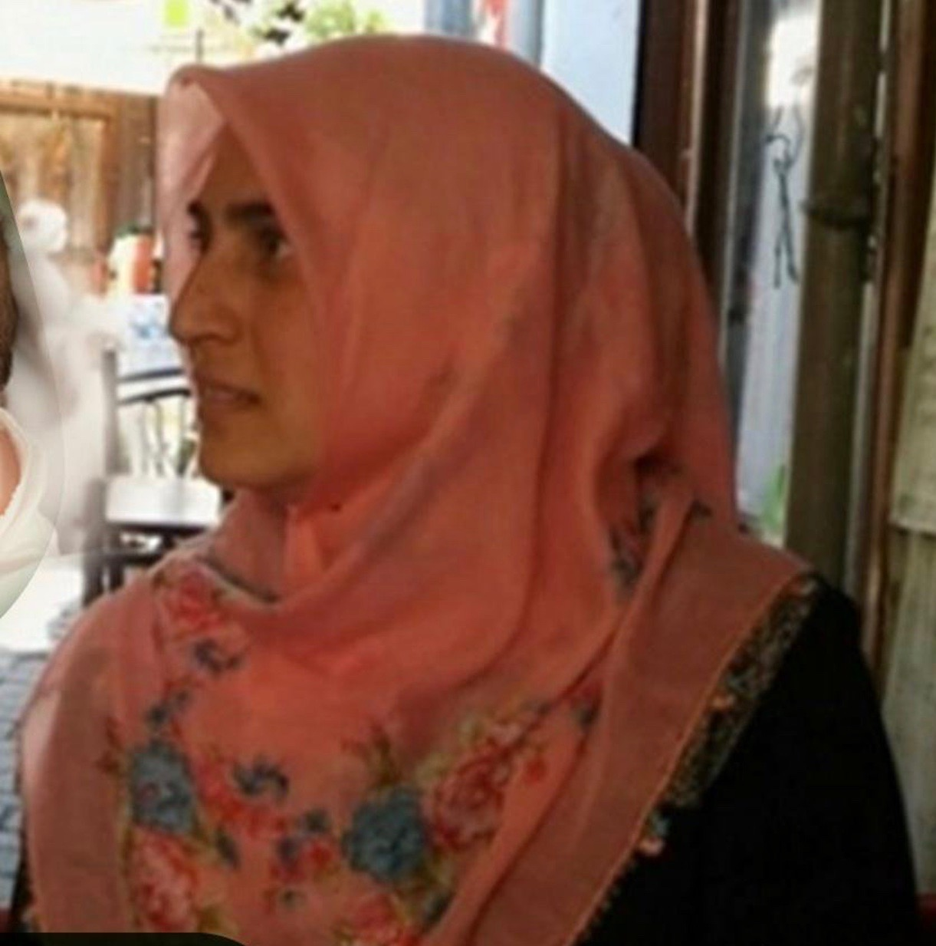
3. Poor conditions of prisons
Prison Capacity: 202,000
Prison Population: 224,000
22,000 inmates sleep on the floor.
RESTRICTED IN PRISON:
Tv and Radio
Books
Courses, cultural art events
Gym facilities

Slide 7
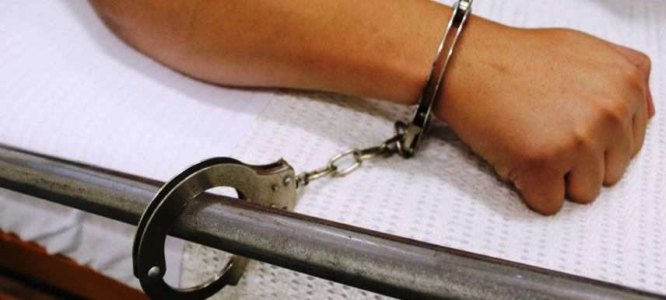
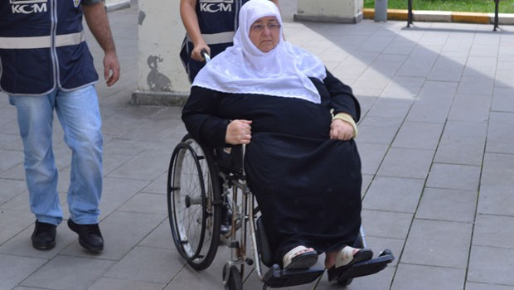
4. Denial of Health Services
European Prison Rules “Prisoners shall have access to the health services in the country without discrimination on the grounds of their legal situation”.
Human Rights Association (İHD) has stated that in Turkey there are 1,025 prisoners in poor health, 357 of whom are seriously ill, subjected to deplorable conditions.

Slide 8
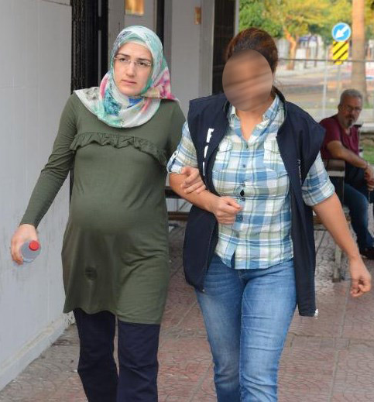
Turkish Penal Code states “ the sentence of imprisonment is to be left behind for women who are pregnant…”

Slide 9
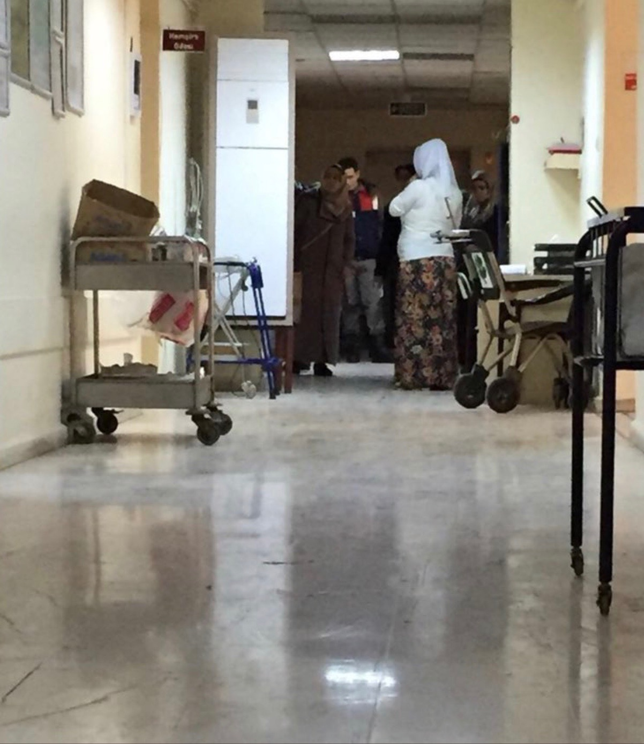
“The sentence of imprisonment is to be left behind for women who have not passed six months since the conception of birth”

Slide 10
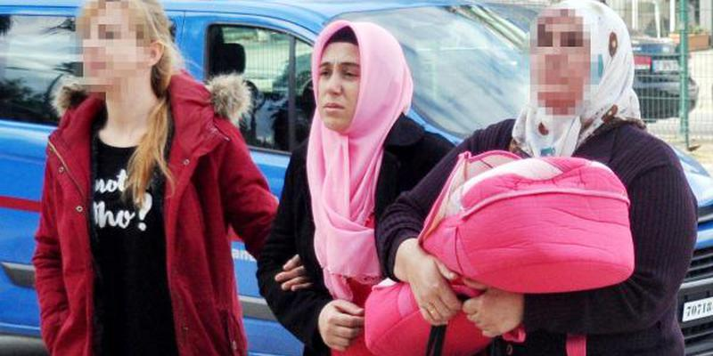
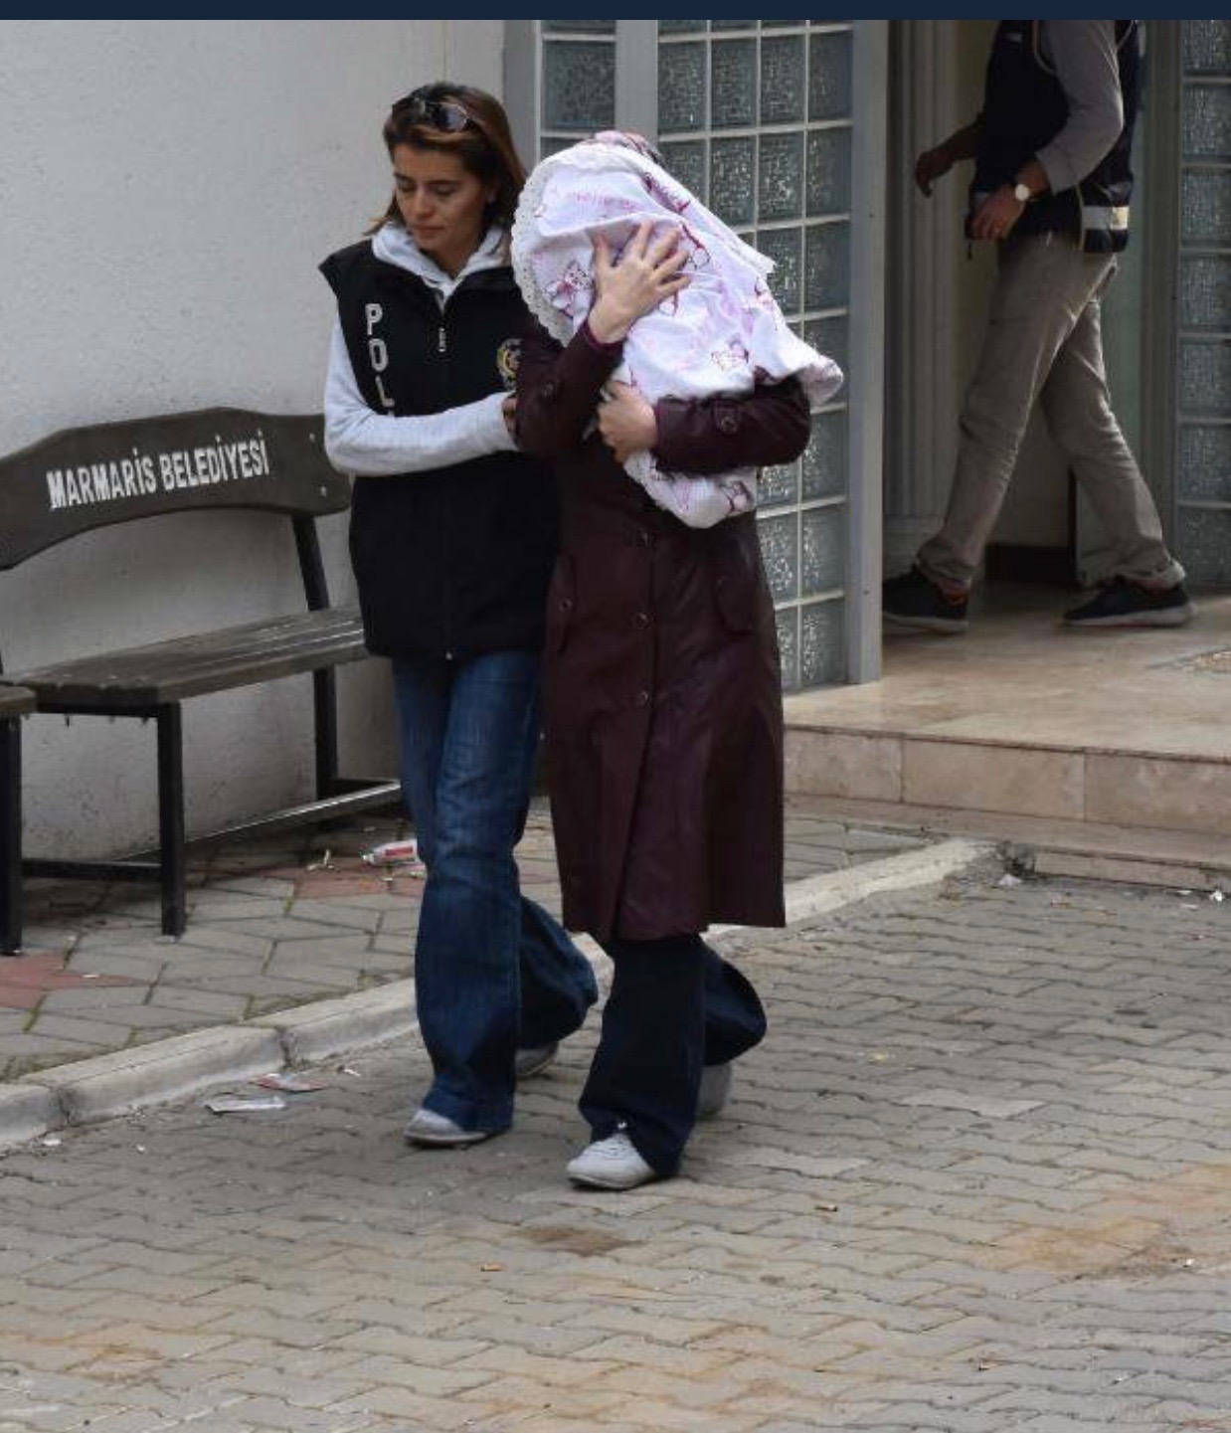
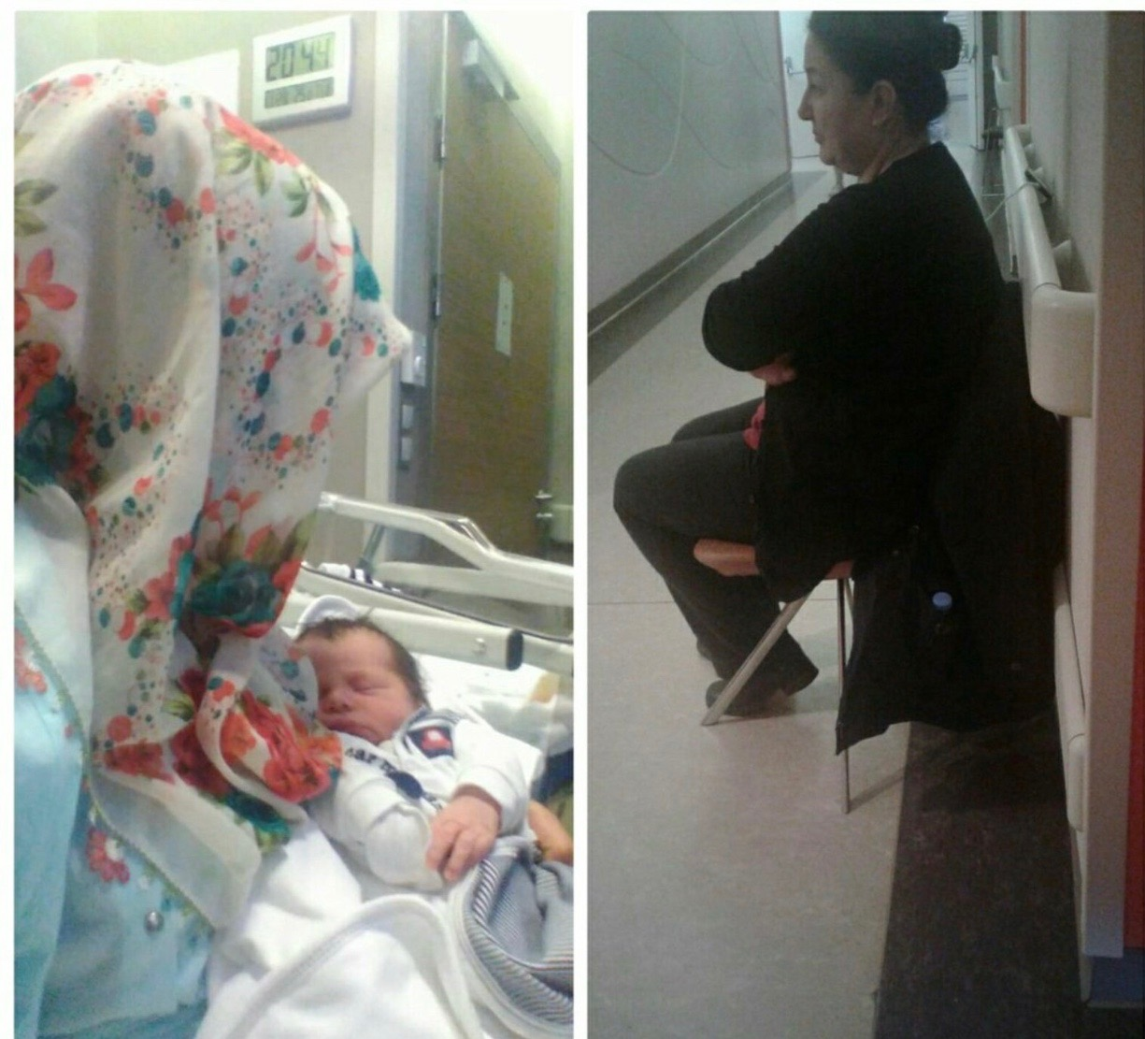

Slide 11
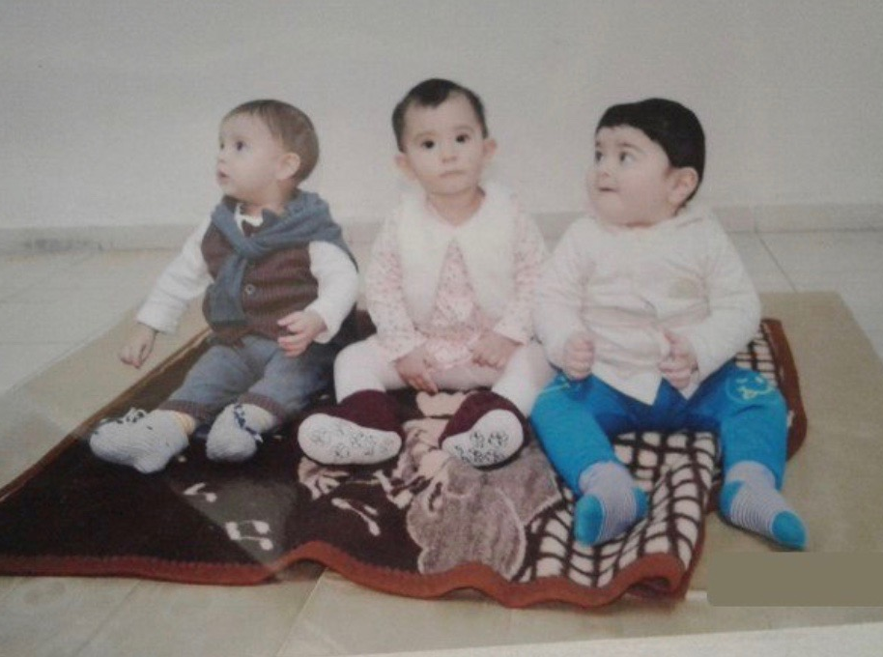
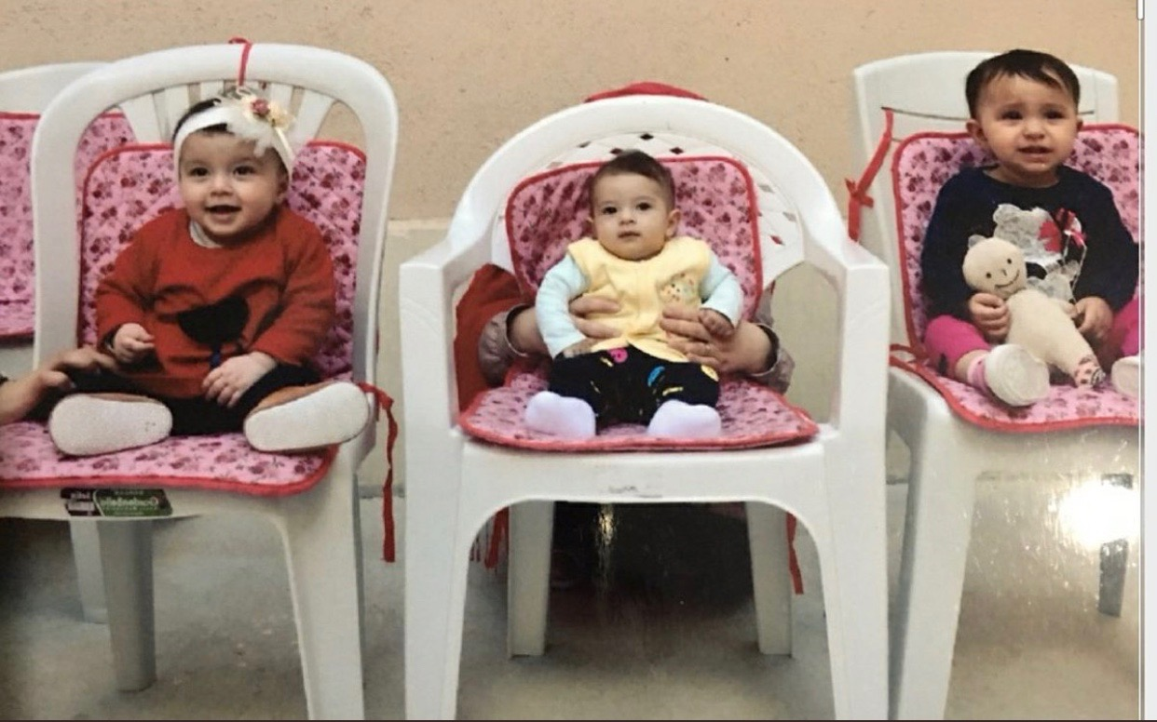
Prison conditions are not satisfactory for the well being of children:
-Crowded, dirty rooms
-Missing fresh air and sky
-Denial of health care
-Shared bed and meal
-No toys

Slide 12
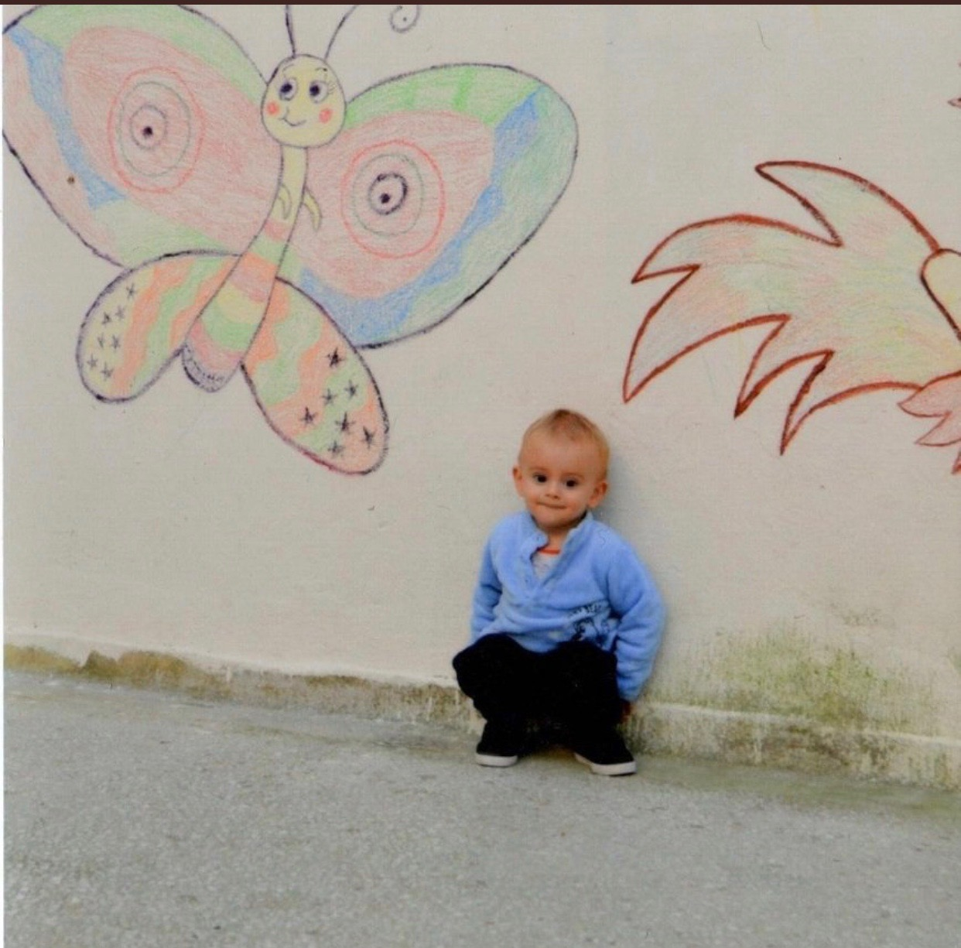
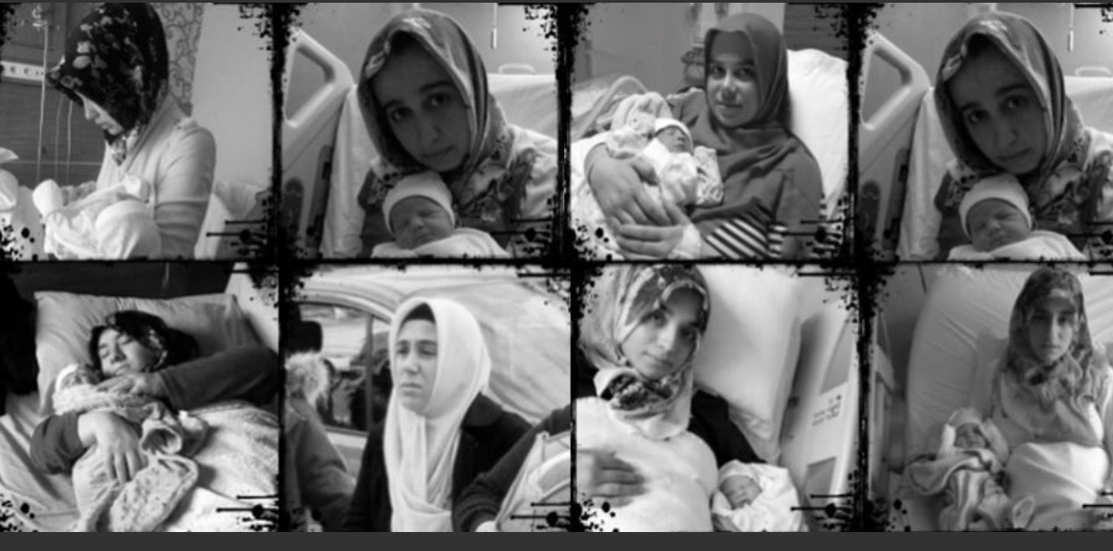
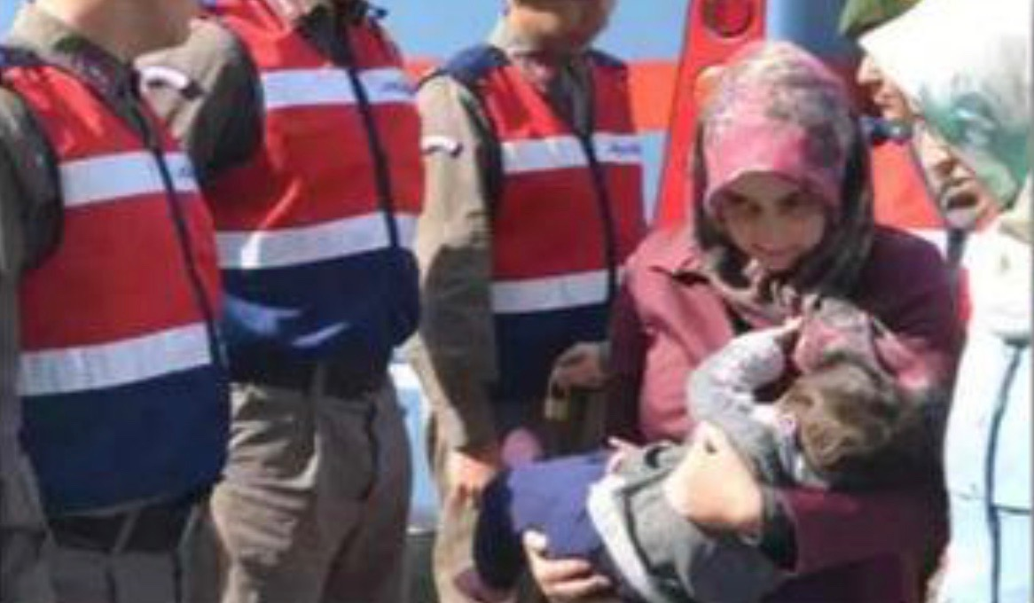
Violations of Convention on the Rights of the Child
Current situation in Turkey is clear violation of the principles of:
-Best Interest of the Child
-Survival and Development
-Adequate Standard of Living

Slide 13

SUPPORT WOMEN AND CHILDREN IN TURKEY
CONTACT US
help@silencedturkey.org
+1 (540) 209-1934
Twitter: @silencedturkey
Facebook: @silencedturkey
Instagram: @silencedturkey
DONATE ONLINE
silencedturkey.org
SEND YOUR
CHECKS
PAYABLE TO:
'Advocates of Silenced Turkey’ to
P.O. Box 2399 Wayne, NJ 07474-2399

